Slide 1



||JAI SRI GURUDEV||
Sri Adichunchanagiri Shikshana Trust ®
SJB INSTITUTE OF TECHNOLOGY
No. 67, BGS Health & Education City, Dr. Vishnuvardhan Road, Kengeri, Bengaluru - 560 060
An Autonomous Institute under VTU
Approved by AICTE - New Delhi, Accredited by NAAC A+, Accredited by NBA
Department of Computer Science & Engineering
SOCIETAL INTERNSHIP
Presented by
Udai KC
1JB21CS165

Slide 2
CERTIFICATE
Certified that the Societal Internship report carried out by Udai KC [1JB21CS165] is a bonafide student of SJB Institute of Technology in partial fulfilment for the award of “BACHELOR OF ENGINEERING” as prescribed by VISVESVARAYA TECHNOLOGICAL UNIVERSITY, BELAGAVI during the academic
year 2023-24. It is certified that all corrections/suggestions indicated for internal assessment have been incorporated in the report deposited in the departmental library. This report has been approved as it satisfies the academic requirements

Slide 3

Internship Certificate

Slide 4


Executive Summary
🠶 The activities included: -
🠶 TEAM INTERACTION WITH STAKEHOLDERS
🠶 DEVELOPMENT OF BASIC MICROSERVICES
🠶 DEPLOYING APPLICATION IN CLOUD
🠶 DEPLOYING APPLICATION OF STAKEHOLDERS
DEVELOPING BUISNESS LOGIC WAS THE TASK THAT WAS ASSIGNED TO ME

Slide 5
Declaration by the Student
I, UDAI KC [1JB21CS165] a student of SJB Institute of Technology, pursuing the “Bachelor of Engineering” in CSE, in the VI Semester, C Section, 2021-2025 batch hereby declare that the “SOCIETAL INTERNSHIP” report is my original work and the same has not been submitted for the award of any other degree.
UDAI KC
1JB21CS165

Slide 6
Table of Contents
🠶 Chapter 1: About the organization
🠶 Chapter 2: About the department
🠶 Chapter 3: activities done
UNDERSTANDING APPLICATION
NODEJS
CREATION OF BASIC EJS FILES
DEPLOYING THEM TO CUSTOMER
🠶 Chapter 4: Reflection notes
🠶 Conclusion

Slide 7


Chapter 1: About The Organization
SKILLRARY IS THE ACADEMIC WING OF THE ENTERPRISE GAINT “DOVER CORPORATION”
THEY ARE THE TALENT ACQUISITION TEAM FOR THE DOVER INDIA
SKILLRARY WORKS WITH DIFFERENT STARTUP TECHNICAL TEAMS TO ASSIST INTERNS FOR THEIR DEVELOPMENT PRODUCT
SKILLRARY SUPPORT STARTUPS WITH HIGH SKILLED INTERNS AND HR ACTIVITIES FOR THE COMPANIES TO PERFORM
PROGRAMS OFFERED BY SKILLRARY ARE:
CLOUD COMPUTING
DEVOPS
BACKEND STACK DEVELOPMENT
OPEN-SOURCE PROJECT
PARENT COMPANY

Slide 8
Chapter 2: About the department
DEVELOPMENTAL TEAM
DEVELOPMENTAL TEAM OF SKILLRARY MAINLY HELPS STARTUPS DEVELOP THEIR BUISNESS LOGIC
THE MAIN PART OF THE TEAM IS TO HAVE INTERACTION WITH THE INDUSTRY MEMBERS FOR FURTHER CONSTAINTS IN THE BUISNESS LOGIN
THE CONSTRAINTS INCLUDE:
THE LONGITY OF BUISNESS LOGIC
THE ELASTICITY OF CLOUD INFRASTRUCTURE
TEAM INTERACTION
MANAGING ROLES TO INTERNS FOR THE COMPANY
EFFECTIVE COST PROGRAMS FOR THE STARTUP PROTOTYPE DEVELOPMENT\
TESTERS FOR THE LOGIC
ELASTICITY OF MICROSERVICES USED IN APPLICATION

Slide 9

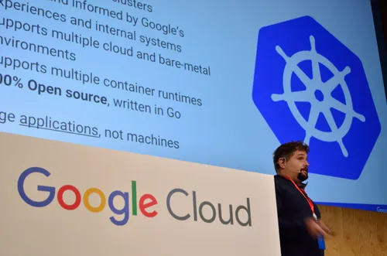
DEVELOPEMENTAL TEAM IN SKILLRARY

Slide 10


UNDERSTANDING APPLICATION
HOSTELWORLD IS A HOSTEL HUNTING COMPANY BASED OUT OF USA
THEIR PRIME OBJECTIVE WAS TO UNDERSTAND THE MARKET OF DIGITAL NOMADS (18 BILLIONS USD)
DIGITAL NOMADS :
AS THE AGE OF INTERNET GROWS AND STRENGTH OF CONNECTIVITY HAS INCREASED TO A NEW LEVEL
THERE ARE BUNCH OF YOUNG SOFTWARE WORKERS , WHO ARE KEEN IN TRAVELING WORLD AND MANGING WORKSPACE
BUT THEY HAVE TO DEAL WITH CERTAIN LEVEL OF CONSTAINTS WHILE TRAVELLING
THOSE ARE :
SEARCHING FOR HOSTELS
STATE TAXES AND GOVT TAXES
UNPLANNED ROUTES TO GO

Slide 11


HOW THE APPLICATION PERFORMS AND UPDATE
APPLICATION USES THE LOW VIRTUAL BLOCKCHAIN CONCEPTS
TO BYPASS THE TAXES IN AN COUNTRY , WE HAD TO USE BLOCKCHAIN FOR THE VALIDATION OF TRANSACTION AND INCREASE IN TRUST
BLOCKCHAIN IS THE DECENTRALISED DATABASE NETWORK THAT USES HIGH COMPUTATION FOR VALIDATION OF THE TRANSACTION

Slide 12

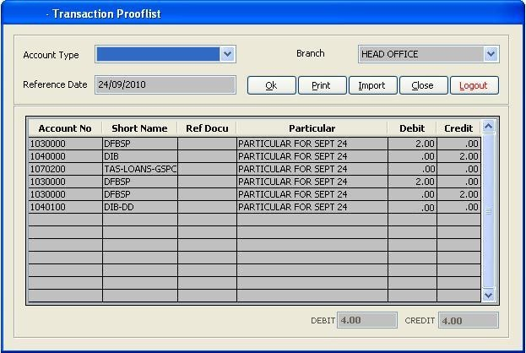
SUPPOSE IF YOU PAY A PERSON $1 DOLLAR TO A
$1 = 16/32 bit hash code that gets updated to everyone
You
A

Slide 13
STAKEHOLDERS and MICROSERVICES
Provides payment gateway interface software and stay listings in INDIA
Provides blockchain
And microservices architecture to the application
Provides the user authentication software and stay authentication in USA

Slide 14


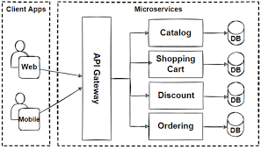
APPLICATION WAS HEAVY TO DEPLOY
COST OF THE CLOUD INCREASED WITH INCREASE IN THE DATA OF THE APPLICATION
EX-WHATSAPP , INSTAGRAM
MICROSERVICES:
Microservices are an architectural and organizational approach to software development where software is composed of small independent services that communicate over well-defined APIs. These services are owned by small, self-contained teams.

Slide 15
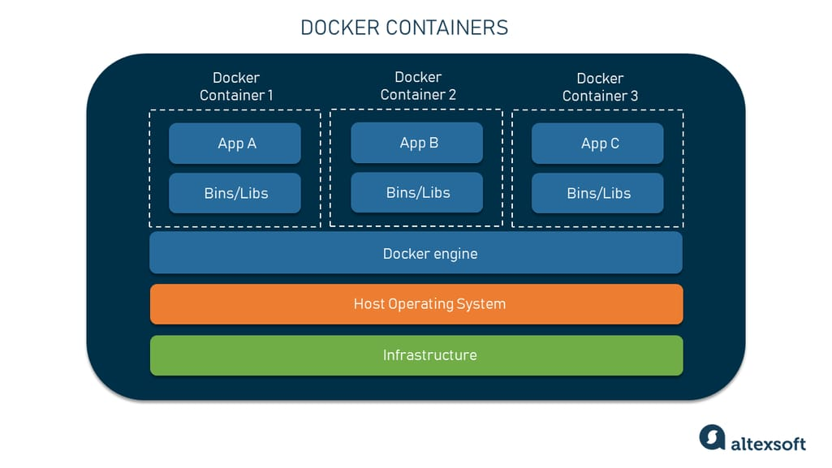
Docker container for large application

Slide 16
REFLECTION NOTES
Implementing blockchain and microservices is often seen as highly rewarding but presents significant challenges. While blockchain promises decentralized, secure, and transparent operations, and microservices offer modular, scalable, and flexible architectures, their practical deployment is complex and demanding. Blockchain implementation requires expertise in cryptography, consensus mechanisms, and regulatory navigation, while microservices demand proficiency in containerization, orchestration, and robust DevOps practices.
Initial enthusiasm must be tempered with an understanding of the long-term commitment, as both technologies involve ongoing maintenance, continuous integration, and security vigilance. The development and operational costs can be substantial, necessitating investment in skilled teams and sophisticated infrastructure. Despite these challenges, the strategic value and potential return on investment can be significant if these technologies are implemented correctly, providing enhanced security, transparency, agility, and scalability in various industries.

Slide 17
CONCLUSION
In conclusion, developing a travel app that leverages blockchain and microservices for elastic services proved to be a highly rewarding endeavor. The implementation process, though complex and demanding, was invaluable in understanding the intricacies of these cutting-edge technologies. Blockchain provided unmatched security and transparency for transactions, while the microservices architecture ensured scalability and flexibility, allowing the app to adapt seamlessly to varying user demands. The journey involved mastering cryptographic techniques, efficient service orchestration, and robust DevOps practices, ultimately resulting in a highly reliable and efficient system. This experience underscored the importance of a thorough comprehension of each process, demonstrating that the initial effort and investment were well worth it for the significant strategic advantages and enhanced user experience achieved.

